Slide 1
The Life of Jesus Christ Lesson 11 – In Galilee And Beyond
May 6, 2020
Feeding of the Four Thousand
Matthew 15:29-39; Mark 7:31 - 8:10
The Leaven of the Pharisees Matthew 15:39-16:12; Mark 8:10-26

Slide 2
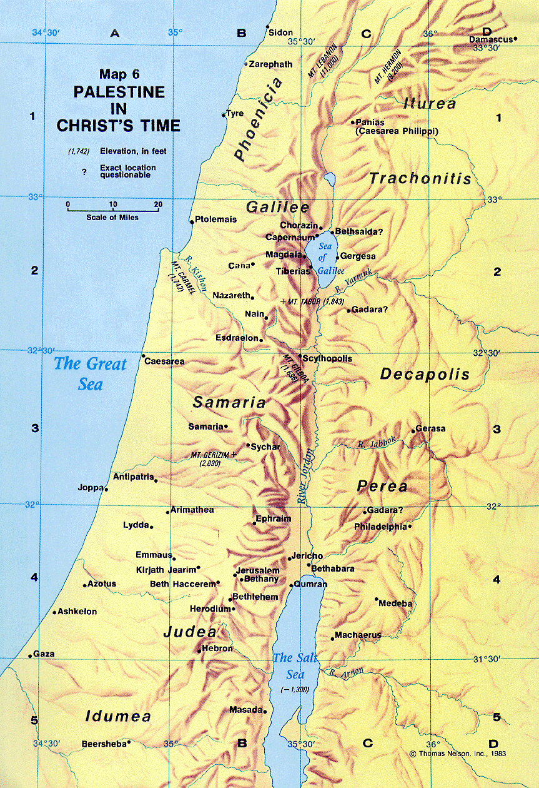
Feeding Of The 4000 Matthew 15:29-39; Mark 7:31-8:10

Slide 3
Feeding Of The 4000 Matthew 15:29-39; Mark 7:31-8:10
“Again He went out from the region of Tyre, and came through Sidon to the Sea of Galilee, within the region of Decapolis.” (Mark 7:31)
“Departing from there, Jesus went along by the Sea of Galilee, and having gone up on the mountain, He was sitting there.” (Matthew 15:29)
“Sitting” – Where is Jesus now sitting?
(Luke 22:69; Acts 2:34; Colossians 3:1)
Notes:
“Sitting” - when applied to Jesus Christ, it applies to His position of authority and dominion. NT:2521
“of Christ's position of authority on the throne of God” (Vine's Expository Dictionary)

Slide 4
Feeding Of The 4000 Matthew 15:29-39; Mark 7:31-8:10
“And large crowds came to Him, bringing with them those who were lame, crippled, blind, mute, and many others, and they laid them down at His feet; and He healed them. So the crowd marveled as they saw the mute speaking, the crippled restored, and the lame walking, and the blind seeing; and they glorified the God of Israel.” (Matthew 15:30-31; cf. Luke 7:22)
Note who they ascribed glory to! (Matthew 9:8; John 15:7-8; 12:28; 17:1)
One in particular is noted in Mark 7:31-37
Notes:
Mark 7:32-37 relates one specific account of healing of a deaf man.
Glorified God - Matthew 9:8 following the healing of the paralytic.
Mark 7:31-37
aAgain He went out from the region of Tyre, and came through Sidon to the Sea of Galilee, within the region of Decapolis. 32 They brought to Him one who was deaf and spoke with difficulty, and they implored Him to lay His hand on him. 33 Jesus took him aside from the crowd, by himself, and put His fingers into his ears, and after spitting, He touched his tongue with the saliva; 34 and looking up to heaven with a deep sigh, He said to him, "Ephphatha!" that is, "Be opened!" 35 And his ears were opened, and the impediment of his tongue was removed, and he began speaking plainly. 36 And He gave them orders not to tell anyone; but the more He ordered them, the more widely they continued to proclaim it. 37 They were utterly astonished, saying, "He has done all things well; He makes even the deaf to hear and the mute to speak.“
The verb rhipto means literally to ‘throw down,’ in sorrow and desperation . . . . While the verse may seem to be an act of cruelty on the part of the crowd, it literally is not. The fact that the sick are thrown down at the feet of Jesus means that the crowd placed these desperately ill people into a position of respect, worship, and intercession (41).

Slide 5
Feeding Of The 4000 Matthew 15:29-39; Mark 7:31-8:10
“And Jesus called His disciples to Him, and said, ‘I feel compassion for the people, because they have remained with Me now three days and have nothing to eat; and I do not want to send them away hungry, for they might faint on the way.’ The disciples said to Him, ‘Where would we get so many loaves in this desolate place to satisfy such a large crowd?’” (Matthew 15:32-33)
Similar to the feeding of the 5000 in John 6:1-13 … but different. (Matthew 16:7-11)
What didn’t happen after the feeding of the 4000 that did happen after the feeding of the 5000?
Notes:
Also the feeding of the 5000 addressed in Matthew 14:13-21 - remember the ultimate cause for His compassion.
Audience? Truth commentary raises question of possibility of Gentiles in this part of the sea of Galilee? Bottom line: it doesn’t say.
5000 w/ 5 loaves and 2 fish with 12 full baskets left.
4000 w/ 7 loaves and a “few” small fish. 7 large baskets full.

Slide 6
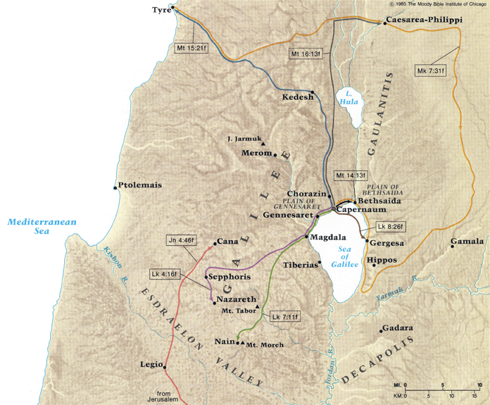
The Leaven of the Pharisees Matthew 15:39-16:12; Mark 8:10-26
v
Notes:
DALMANUTHA - On the W. of the sea of Galilee as what Mark (Mark 8:10) calls "the regions of Dalmanutha." Matthew (Matt 15:39) calls "the borders of Magdala." Magdala was at the S. end of the plain of Gennesaret, near the water. Dalmanutha is probably now 'Ain-el-Barideh, "the cold fountain," surrounded by ancient walls and ruins of a village, at the mouth of a glen a mile S. of Magdala, near the beach.
(from Fausset's Bible Dictionary)

Slide 7
The Leaven of the Pharisees Matthew 15:39-16:12; Mark 8:10-26
“The Pharisees and Sadducees came up, and testing Jesus, they asked Him to show them a sign from heaven.” (16:1; cf. John 6:30; 20:20-31)
Pharisees and Sadducees together. (Matthew 3:8)
“Argue” or engage in a dispute (Mark 8:11) with Jesus, “testing” (“maliciously, craftily” (Thayer))
“But He replied to them, ‘When it is evening, you say, 'It will be fair weather, for the sky is red.' And in the morning, ‘There will be a storm today, for the sky is red and threatening.’ Do you know how to discern the appearance of the sky, but cannot discern the signs of the times?’” (16:2-3)
What type of sign did they want? (John 6:26)
Notes:
DALMANUTHA - On the W. of the sea of Galilee as what Mark (Mark 8:10) calls "the regions of Dalmanutha." Matthew (Matt 15:39) calls "the borders of Magdala." Magdala was at the S. end of the plain of Gennesaret, near the water. Dalmanutha is probably now 'Ain-el-Barideh, "the cold fountain," surrounded by ancient walls and ruins of a village, at the mouth of a glen a mile S. of Magdala, near the beach.
(from Fausset's Bible Dictionary)
Matthew 22:34 - the Pharisees and Sadducees take turns testing Jesus. Commissioned by the Sanhedrin?

Slide 8
The Leaven of the Pharisees Matthew 15:39-16:12; Mark 8:10-26
Jesus’ reply:
“But He replied to them …”
Mark’s account adds: “Sighing deeply in His spirit …” (verse 12)
“to give forth a deep-drawn sigh …” (Zodhiates)
Notes:
“Sighing deeply” - can you imagine? Shows the humanity of Jesus.
“to groan with intensity and can mean to vent censorious feelings… reveals the exasperation” (Truth Commentary by Stauffer)

Slide 9
The Leaven of the Pharisees Matthew 15:39-16:12; Mark 8:10-26
Jesus’ reply:
“… ‘When it is evening, you say, 'It will be fair weather, for the sky is red.' And in the morning, ‘There will be a storm today, for the sky is red and threatening.’ Do you know how to discern the appearance of the sky, but cannot discern the signs of the times?”’” (16:2-3)
Able to “discern” temporal matters but not spiritual. (Philippians 1:9; Hebrews 5:14)
Through their knowledge of the OT scriptures, they should have been able to discern the times and signs to recognize. (Acts 13:27, “recognizing neither Him nor the utterances of the prophets which are read every Sabbath, fulfilled these by condemning Him …”)
There’s still the need to use the scriptures to help others “discern” the kingdom of God.
Notes:
Acts 13:27, “recognizing not” “not to know (through lack of information or intelligence); by implication, to ignore (through disinclination):” (Strong’s)
Pliny the Elder described the same method of predicting fair and foul weather (Natural History 18.78). Lenski explains this phenomenon as the result of Palestine’s
position near the Mediterranean. Wind driving precipitation over the sea in the evening produces a red sky, indicating fair weather the next day. On the other hand, a red sky in the morning reveals the wind has driven precipitation over land from the sea during the night, indicating there will be foul weather (611).

Slide 10
The Leaven of the Pharisees Matthew 15:39-16:12; Mark 8:10-26
“An evil and adulterous generation seeks after a sign; and a sign will not be given it, except the sign of Jonah.” (16:4)
“Evil” – “diseased” (Thayer) (John 3:19; Hebrews 3:12; cf. Isaiah 1:5-6; Jeremiah 30:12-15)
“Adulterous” – unfaithful to God (Romans 7:3; James 4:4).
What was their idol?
Traditions of men.
Notes:
“Faithless to God, unclean, apostate.” (Thayer)
John 3:19
"This is the judgment, that the Light has come into the world, and men loved the darkness rather than the Light, for their deeds were evil.
Heb 3:12-14 - Take care, brethren, that there not be in any one of you an evil, unbelieving heart that falls away from the living God. 13 But encourage one another day after day, as long as it is still called "Today," so that none of you will be hardened by the deceitfulness of sin.”
Reference Ezekiel 16:1-32 when God accuses His people of harlotry.
they had left Jehovah and his prophets and were guided by the traditions of men—they simply had given their love and affection to their own doctrines rather than to the law of God: this made them ‘adulterous’”

Slide 11
The Leaven of the Pharisees Matthew 15:39-16:12; Mark 8:10-26
“An evil and adulterous generation seeks after a sign; and a sign will not be given it, except the sign of Jonah.” (16:4)
“The sign of Jonah”. Not explained in this reference as it was earlier. (Matthew 12:39-40)
Jesus’ death, burial, and resurrection would be the only proof needed. “… having furnished proof to all men by raising Him from the dead.” (Acts 17:31; cf. Romans 1:4)
Notes:
“Faithless to God, unclean, apostate.” (Thayer)
John 3:19
"This is the judgment, that the Light has come into the world, and men loved the darkness rather than the Light, for their deeds were evil.
Heb 3:12-14 - Take care, brethren, that there not be in any one of you an evil, unbelieving heart that falls away from the living God. 13 But encourage one another day after day, as long as it is still called "Today," so that none of you will be hardened by the deceitfulness of sin.”
Reference Ezekiel 16:1-32 when God accuses His people of harlotry.
they had left Jehovah and his prophets and were guided by the traditions of men—they simply had given their love and affection to their own doctrines rather than to the law of God: this made them ‘adulterous’”

